Slide 1
Screenshots of Power BI
− Report View
− Data View
− Model View
− Power Query Editor
− Advance Editor

Slide 2
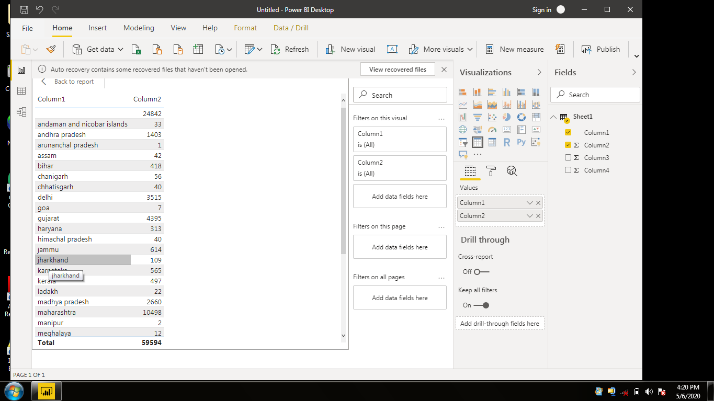

Slide 3
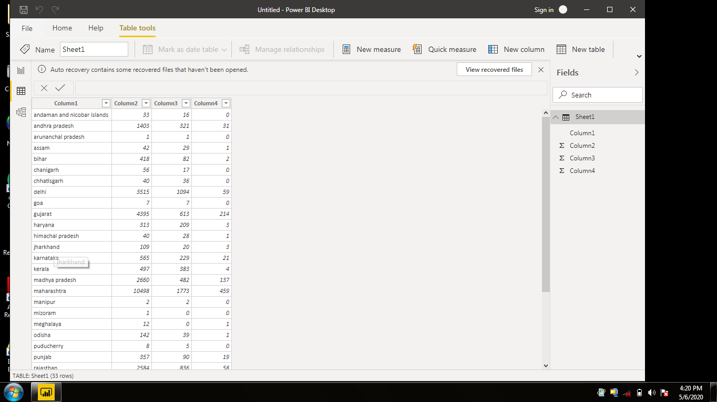

Slide 4
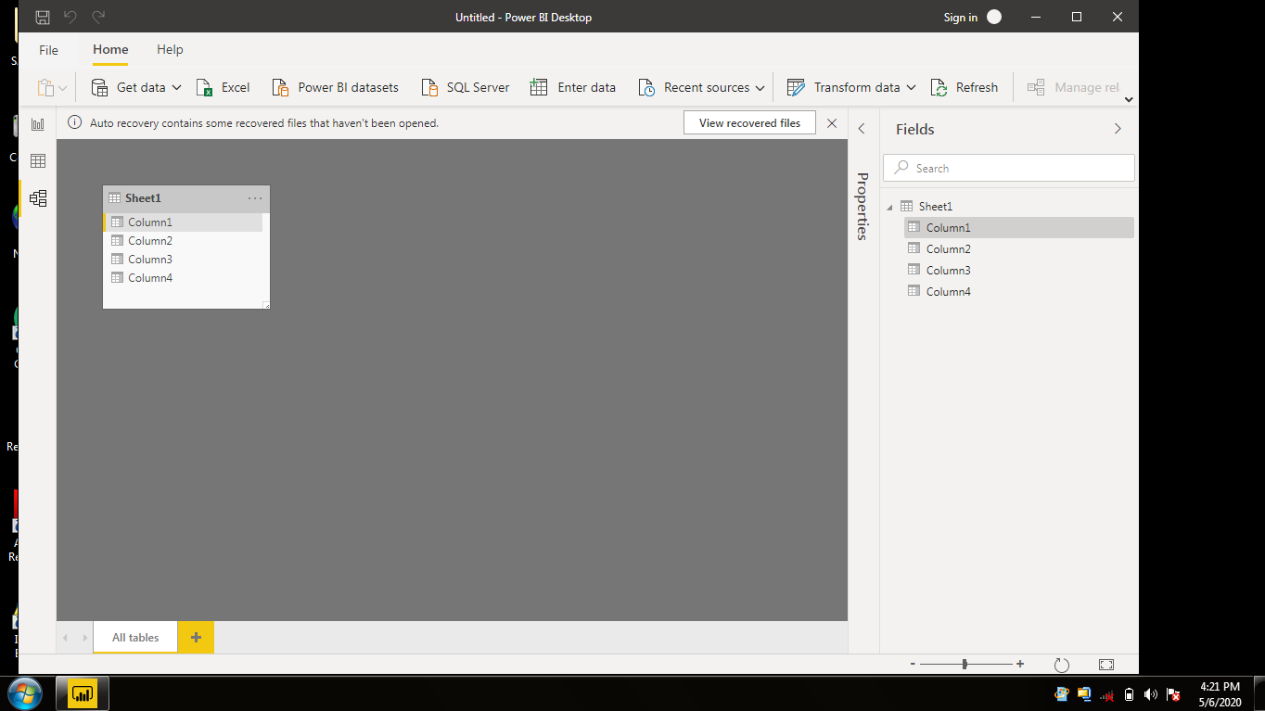

Slide 5
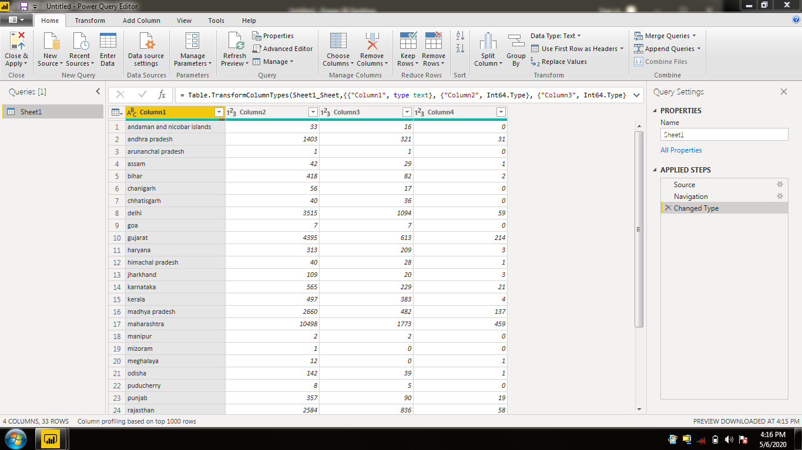

Slide 6
